Slide 1
The Pentecostal Assemblies of the West Indies International
PAWI MONTH
February 2025

Slide 2
VISION
To be a vibrant, global organization, built upon sound biblical truths and unity, which utilizes its resources to serve all people.

Slide 3
MISSION
PAWI exists to fulfill the purpose of God by transforming people and communities everywhere, by the gospel of Jesus Christ, through the power and manifestation of the Holy Spirit for the glory of God.

Slide 4
CORE VALUES
ACCOUNTABILITY
LOYALTY
GODLINESS
FAITH
We shall take full responsibility for our actions and decisions and will be answerable to their resulting consequences.
We shall be loyal to our commitments and obligations to God, and to our duties and responsibilities.
We shall demonstrate godliness through our adherence to the virtues of God.
We shall rely on, and trust the word of God, as the determining factor for every decision we make.

Slide 5
CORE VALUES
FEAR OF GOD
RESPECT
INTEGRITY
We shall live daily in the fear and reverence of God.
We shall demonstrate utmost respect for ourselves, and for others.
We shall conduct ourselves and the business of PAWI with the highest integrity and uprightness of heart.

Slide 6
ORGANIZATIONAL CHART
GENERAL CONFERENCE
GENERAL EXECUTIVE
NATIONAL
COUNCIL
DISTRICTS
DISTRICTS
Central Trinidad District
North-East Trinidad
District
3. North-West Trinidad
District
4. South Trinidad District
5. Tobago District
Antigua & Barbuda, Guadeloupe, St. Kitts & Nevis and St. Maarten District
Barbados District
Dominica District
Grenada District
Montserrat District
St. Lucia District
St. Vincent & The Grenadines District

Slide 7
DIVINE EMPOWERMENT
CHURCH GOVERNANCE
DISCIPLESHIP
EVANGELISM
WORSHIP
LEADERSHIP
FELLOWSHIP
SEVEN STRATEGIC PILLARS

Slide 8
PAWI’s GENERALS
1964 - 2018

Slide 9
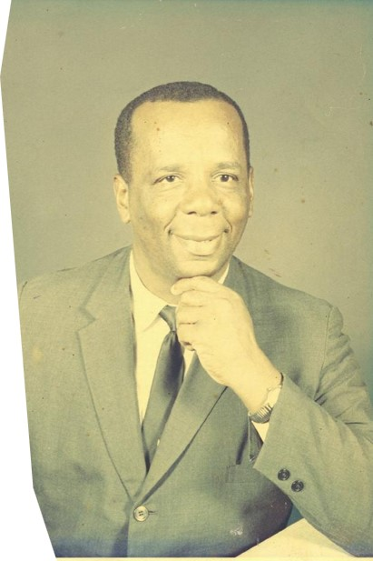
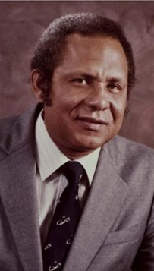
1964-1976
Rev. William P. Ryan
(Deceased)
1976-1982
Rev. Dennis White

Slide 10
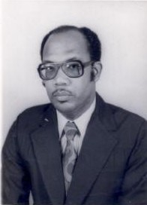
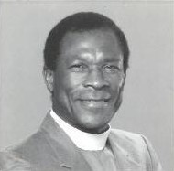
1982-1986
Rev. Frederick Coombs
(deceased)
1986-1988
Rev. Turnel Nelson (deceased)

Slide 11
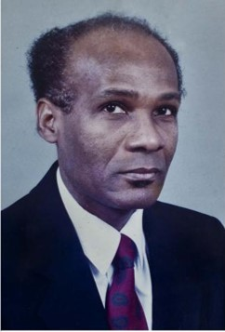
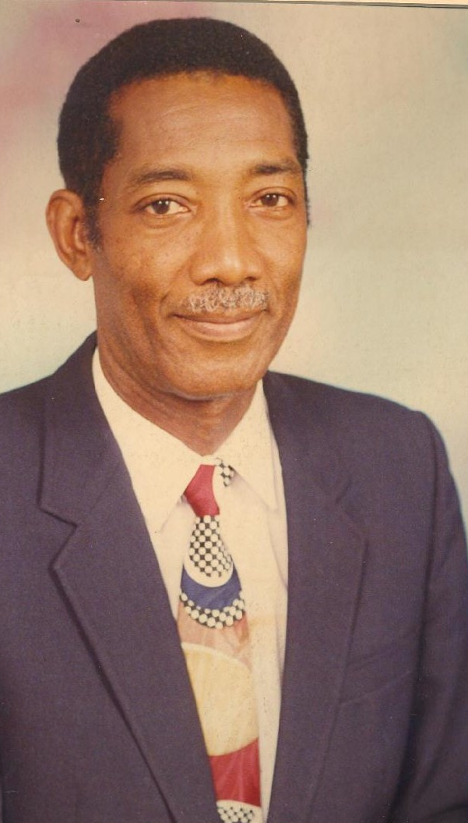
1988-1992
Rev. Alvin Nicholson
1992-1996
Rev. Torrance Bobb

Slide 12
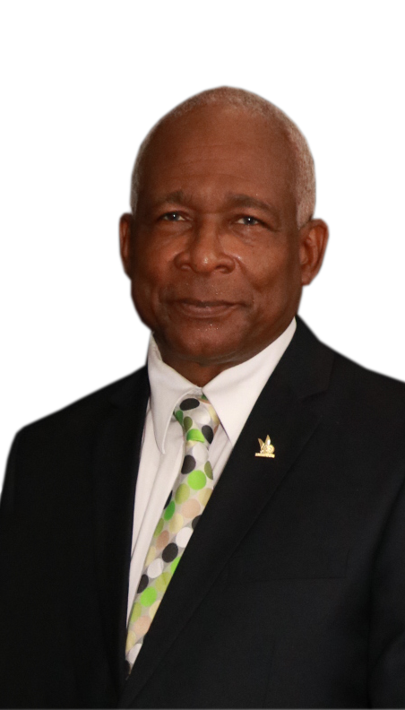
1996-2006
Rev. Turnel Nelson (deceased)
2006-2018
Rev. Pat Glasgow

Slide 13
PAWI’s General Executive 2023-2026
Theme:
Certainty in Uncertain Times: Progressing to Wholeness

Slide 14
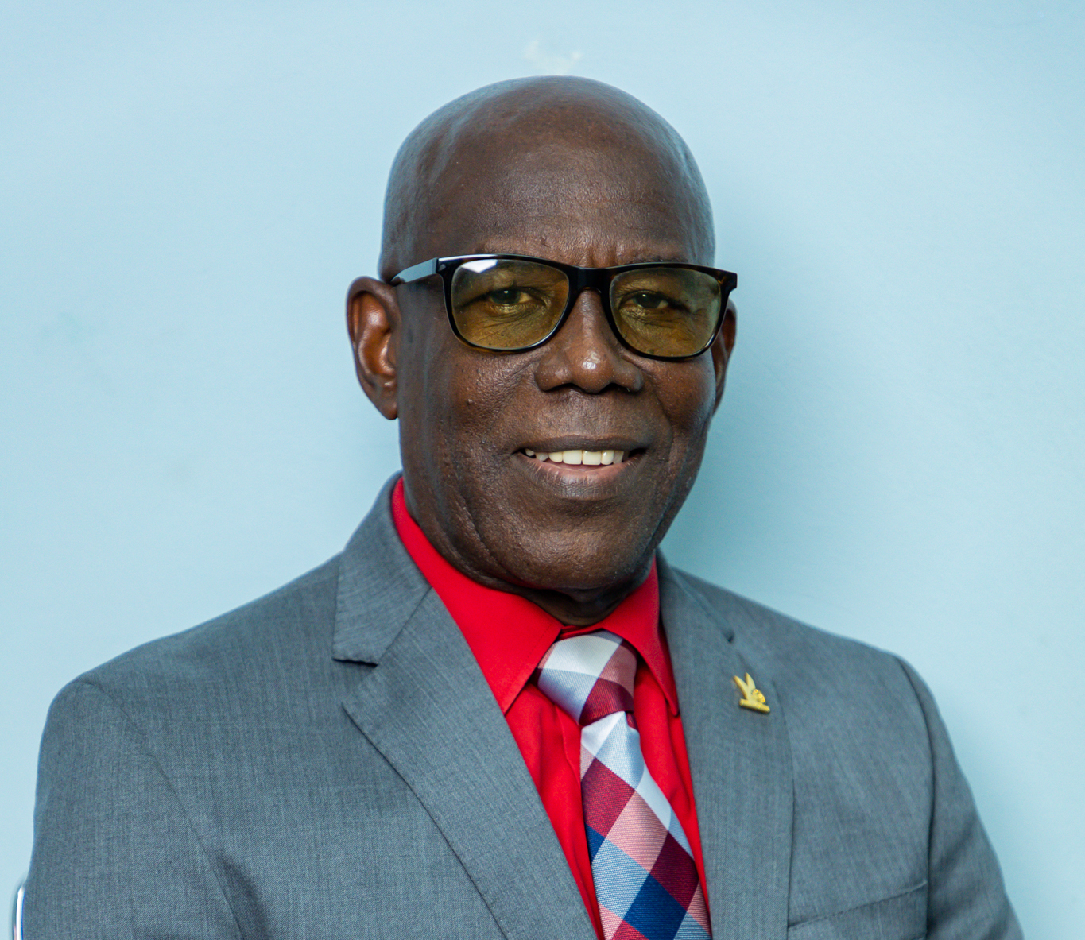
Rev. Sonny Williams
General Bishop

Slide 15
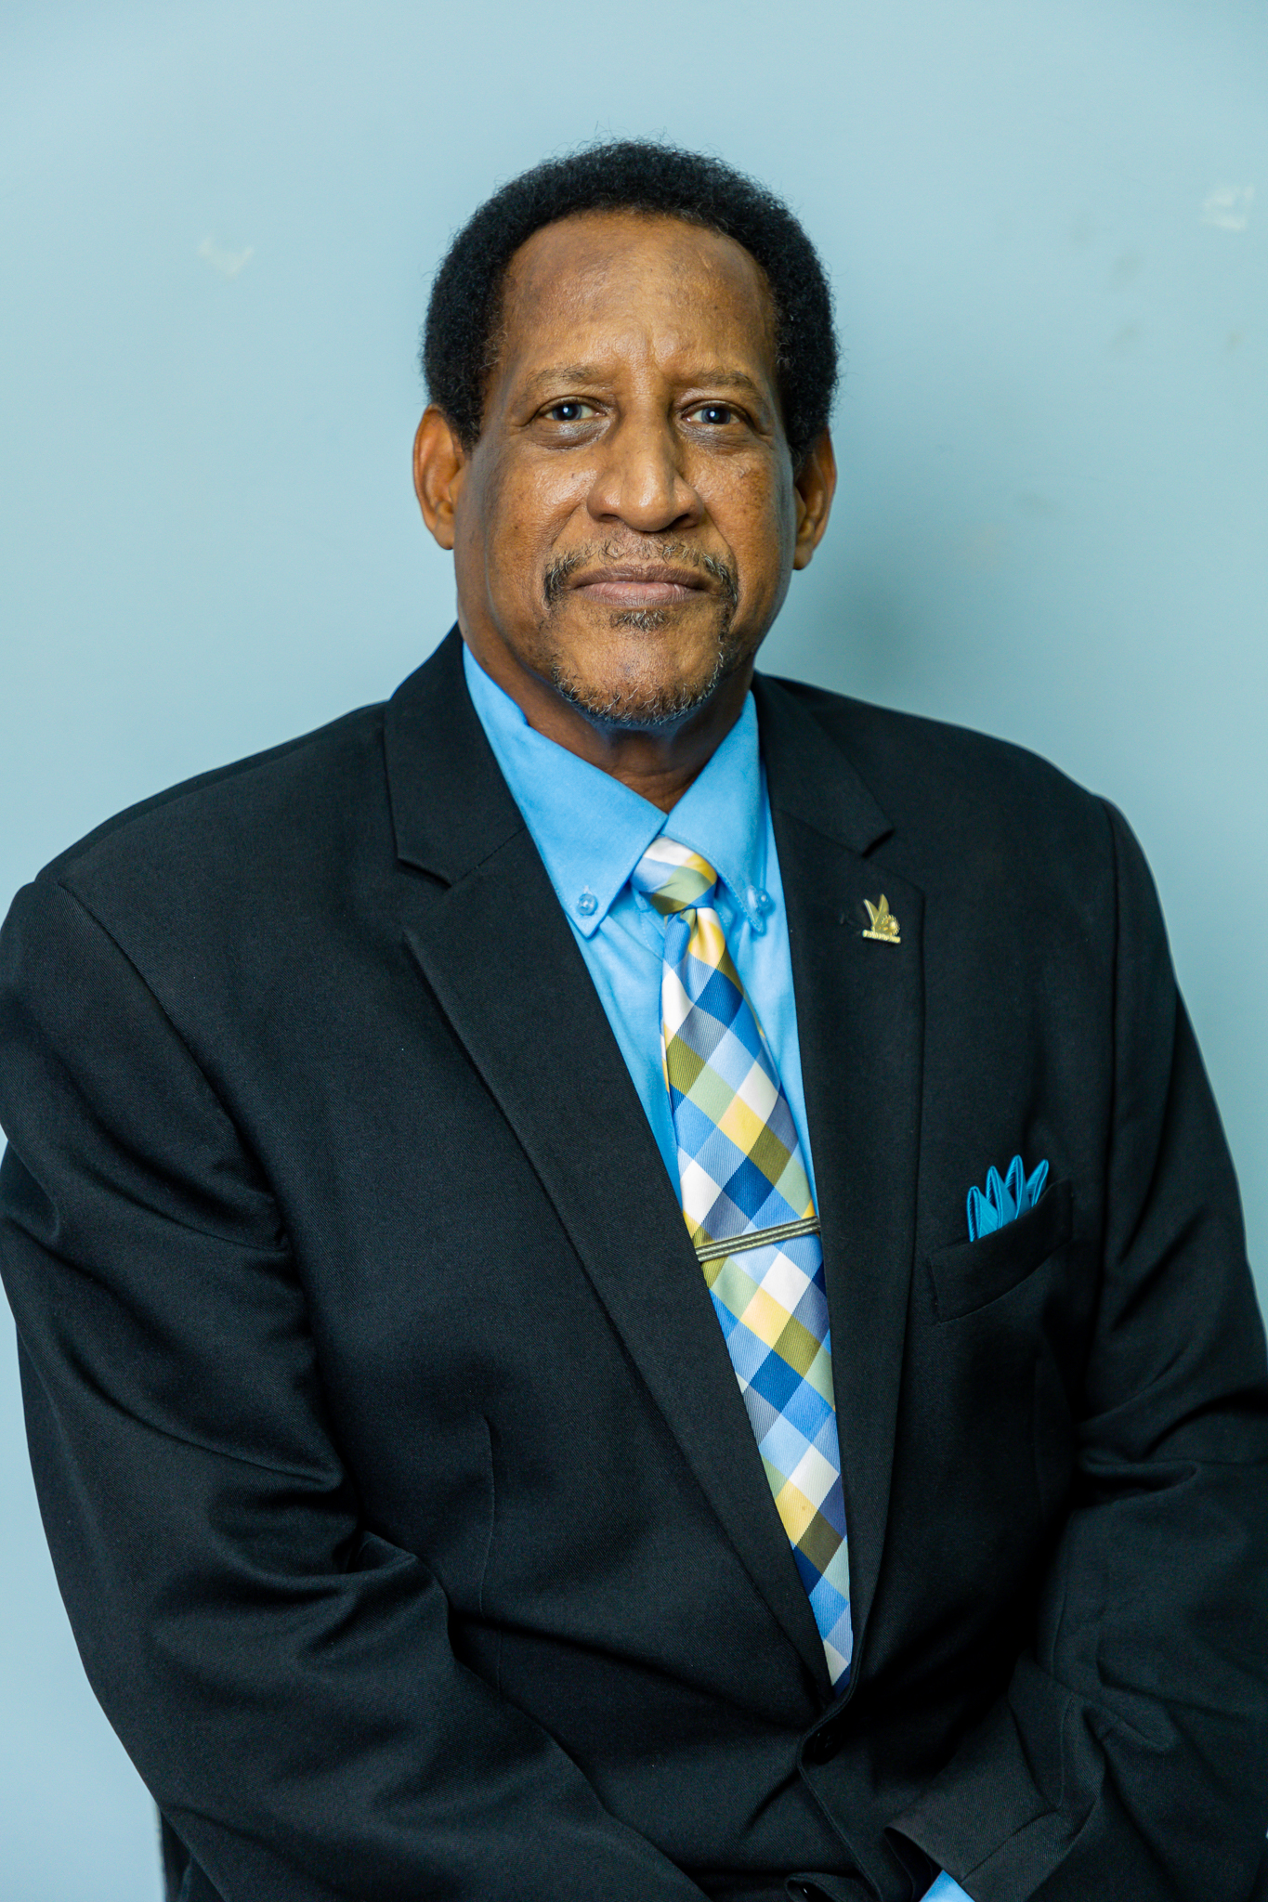
Rev. Dr. Raymond Boca
Asst. General Bishop

Slide 16
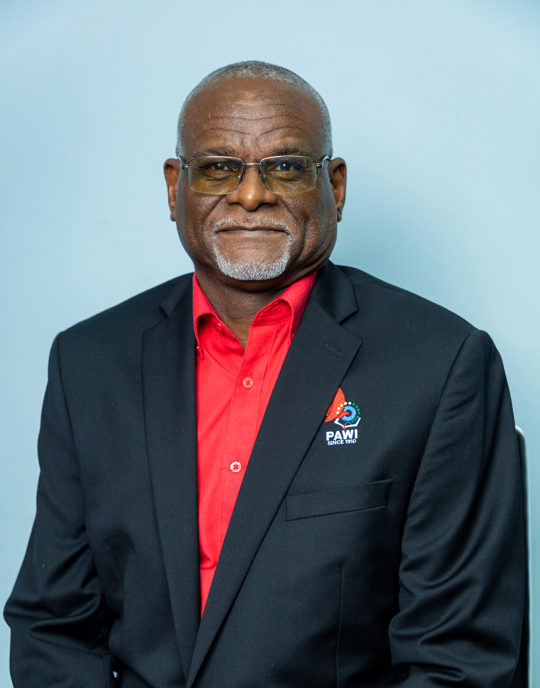
Rev. Dr. Nolan Warner
General Administrator

Slide 17
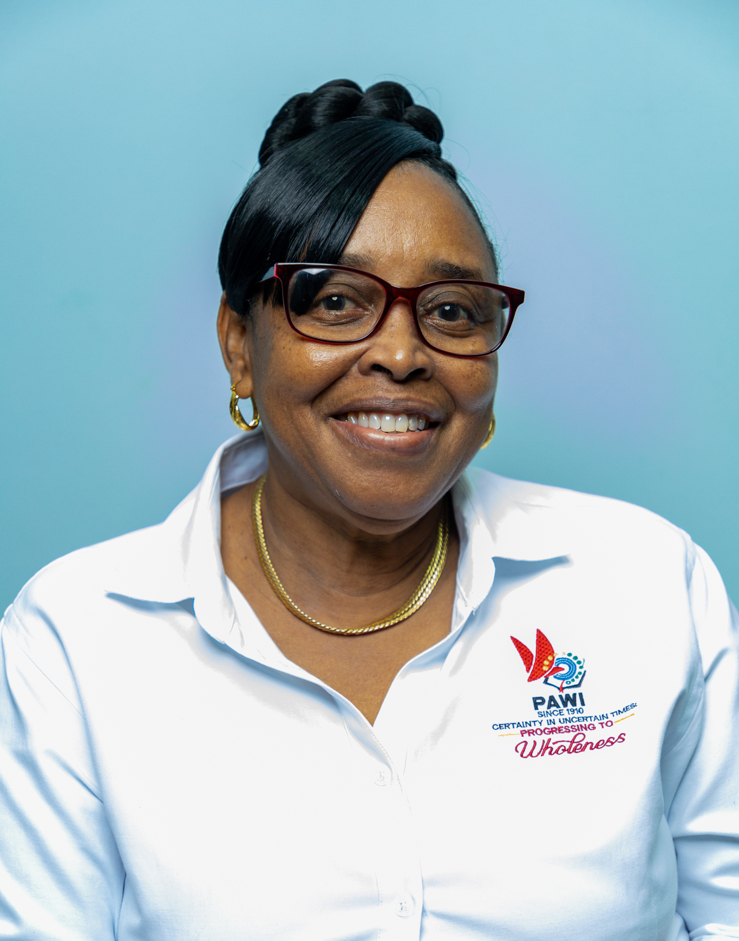
Rev. Cheryl Whiteman
Executive Director of
Church Ministries

Slide 18
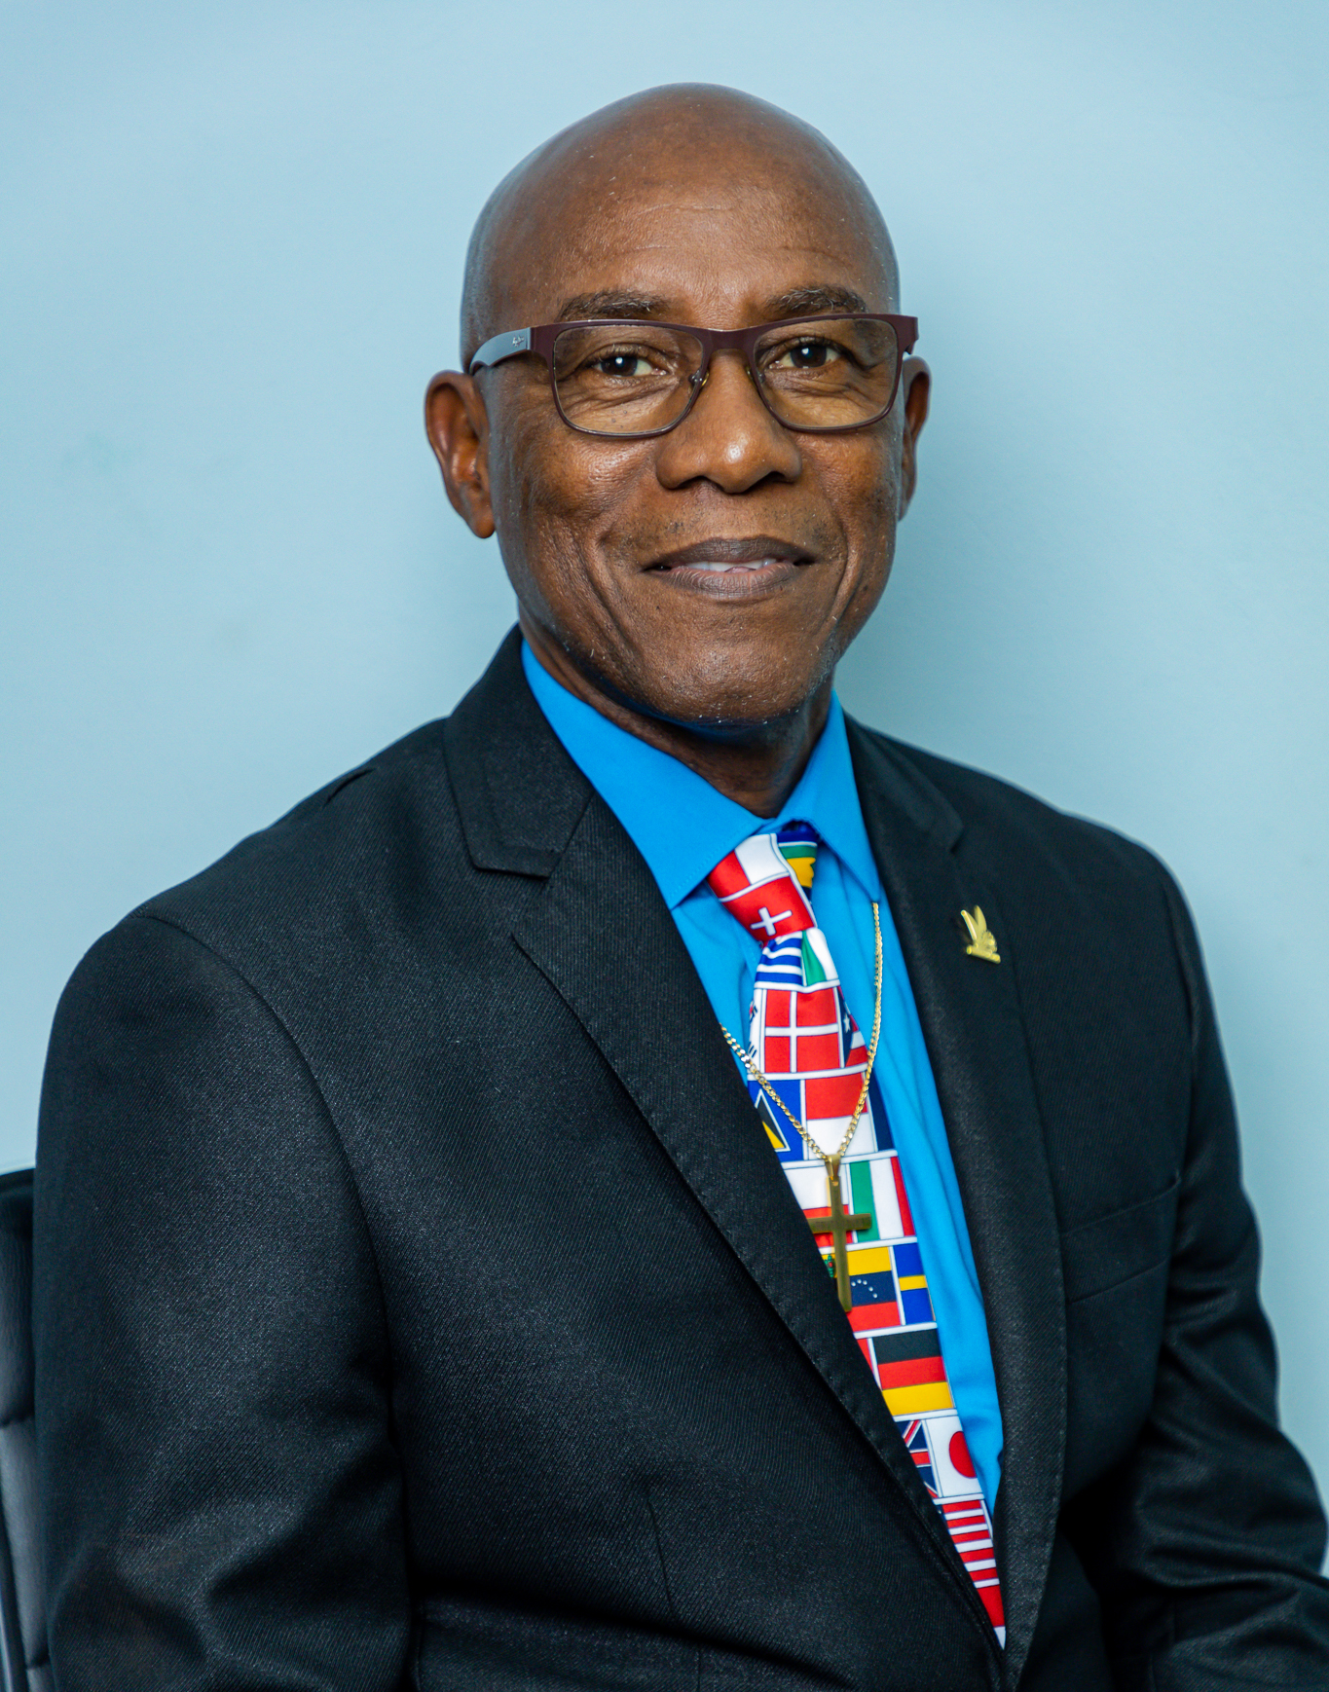
Rev. Ricardo Joseph
Executive Director of
World Missions

Slide 19
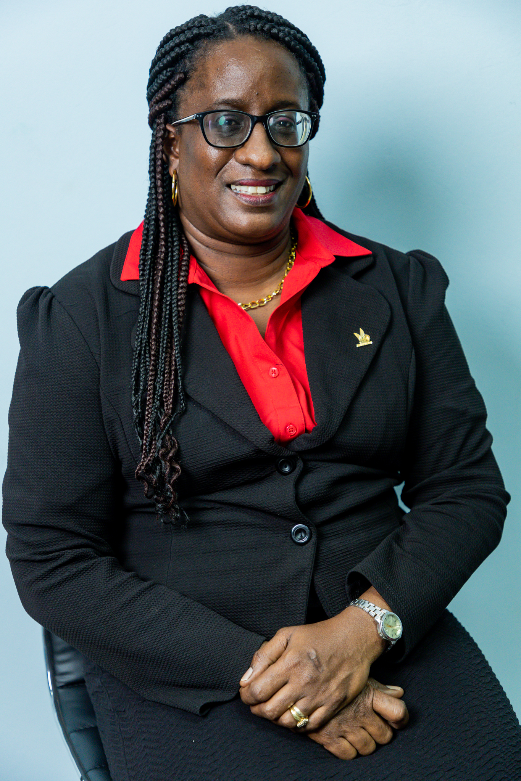
Mrs.
Candia George
Member-at-Large

Slide 20
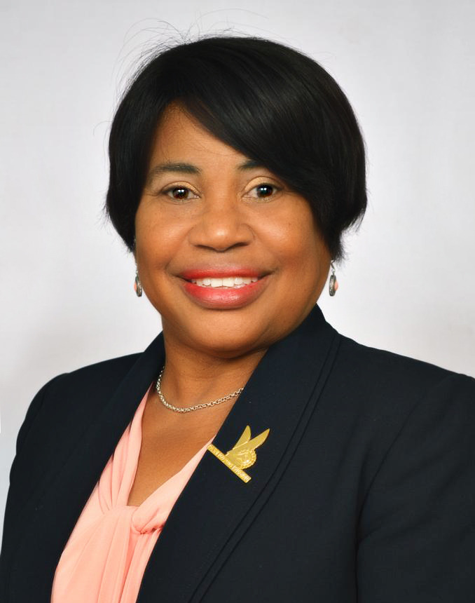
Ms.
Valerie Charles
Member-at-Large

Slide 21
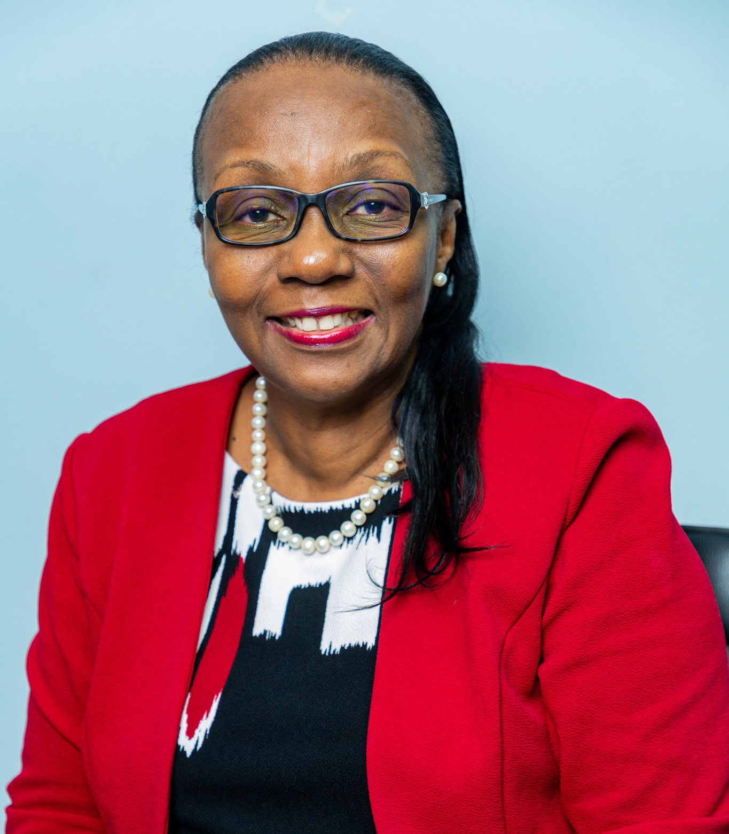
Mrs.
Andrea Phillips
Chairman, WIST
Board of Directors

Slide 22
DISTRICT PRESIDING BISHOPS

Slide 23
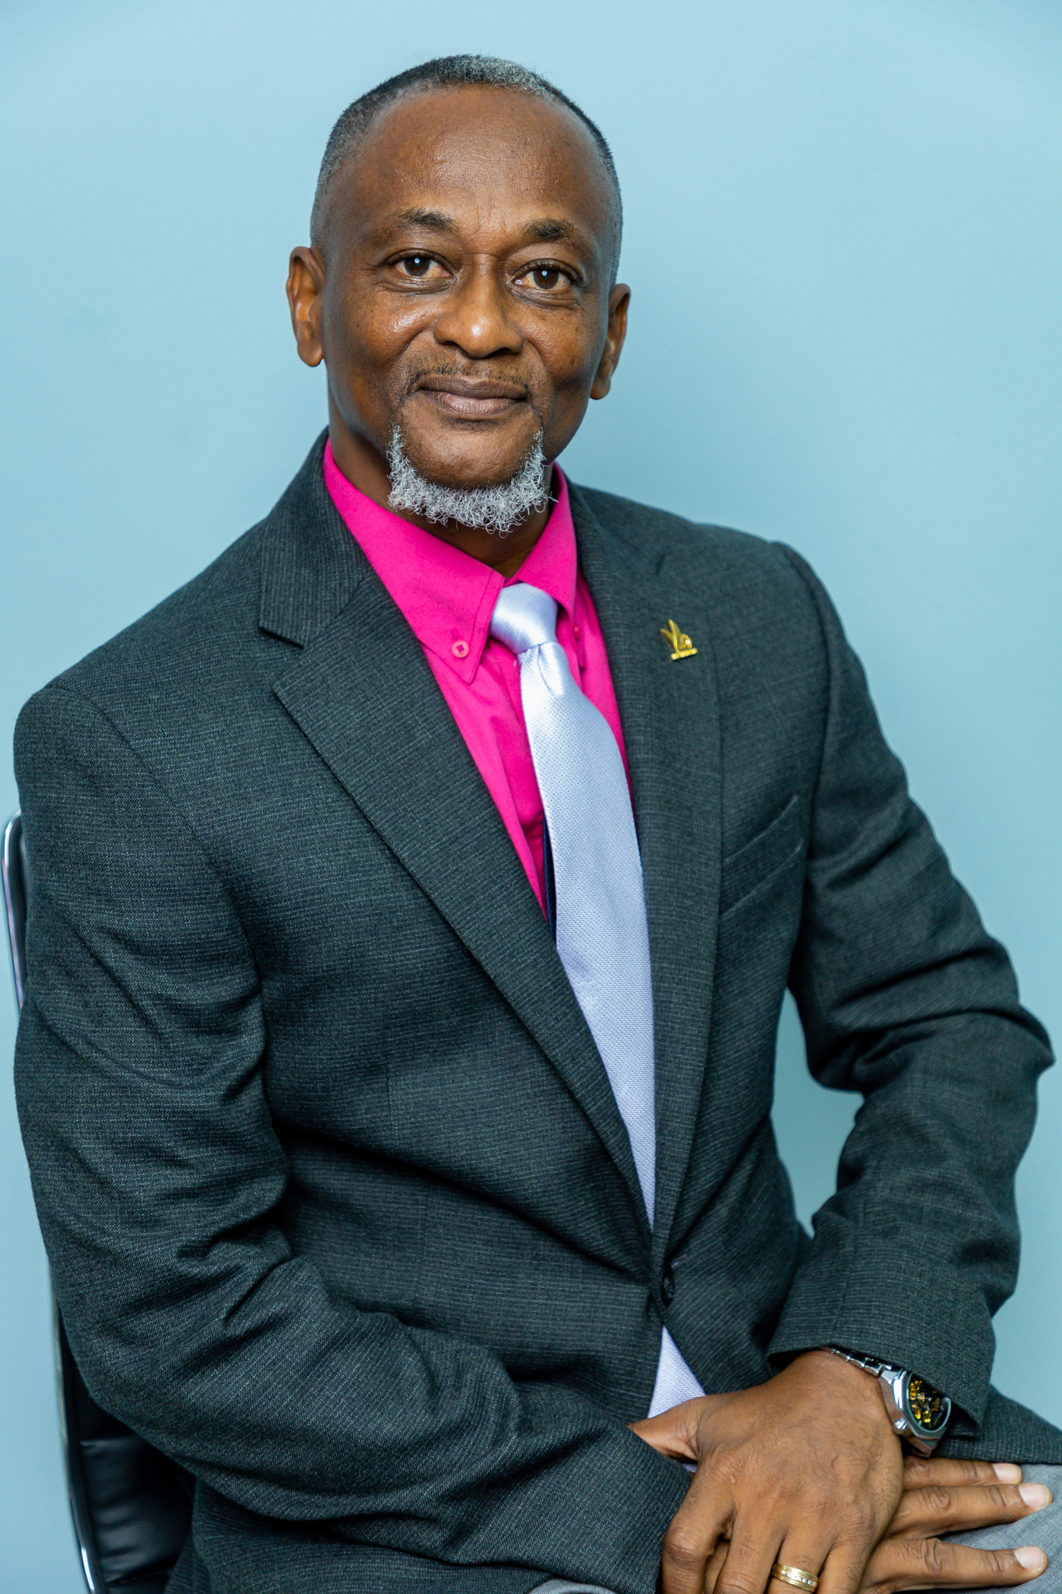
ANTIGUA & BARBUDA GUADELOUPE, ST. KITTS & NEVIS AND ST. MAARTEN
Bishop Lyndon Mottley
Credential Workers - 24
Churches - 17

Slide 24
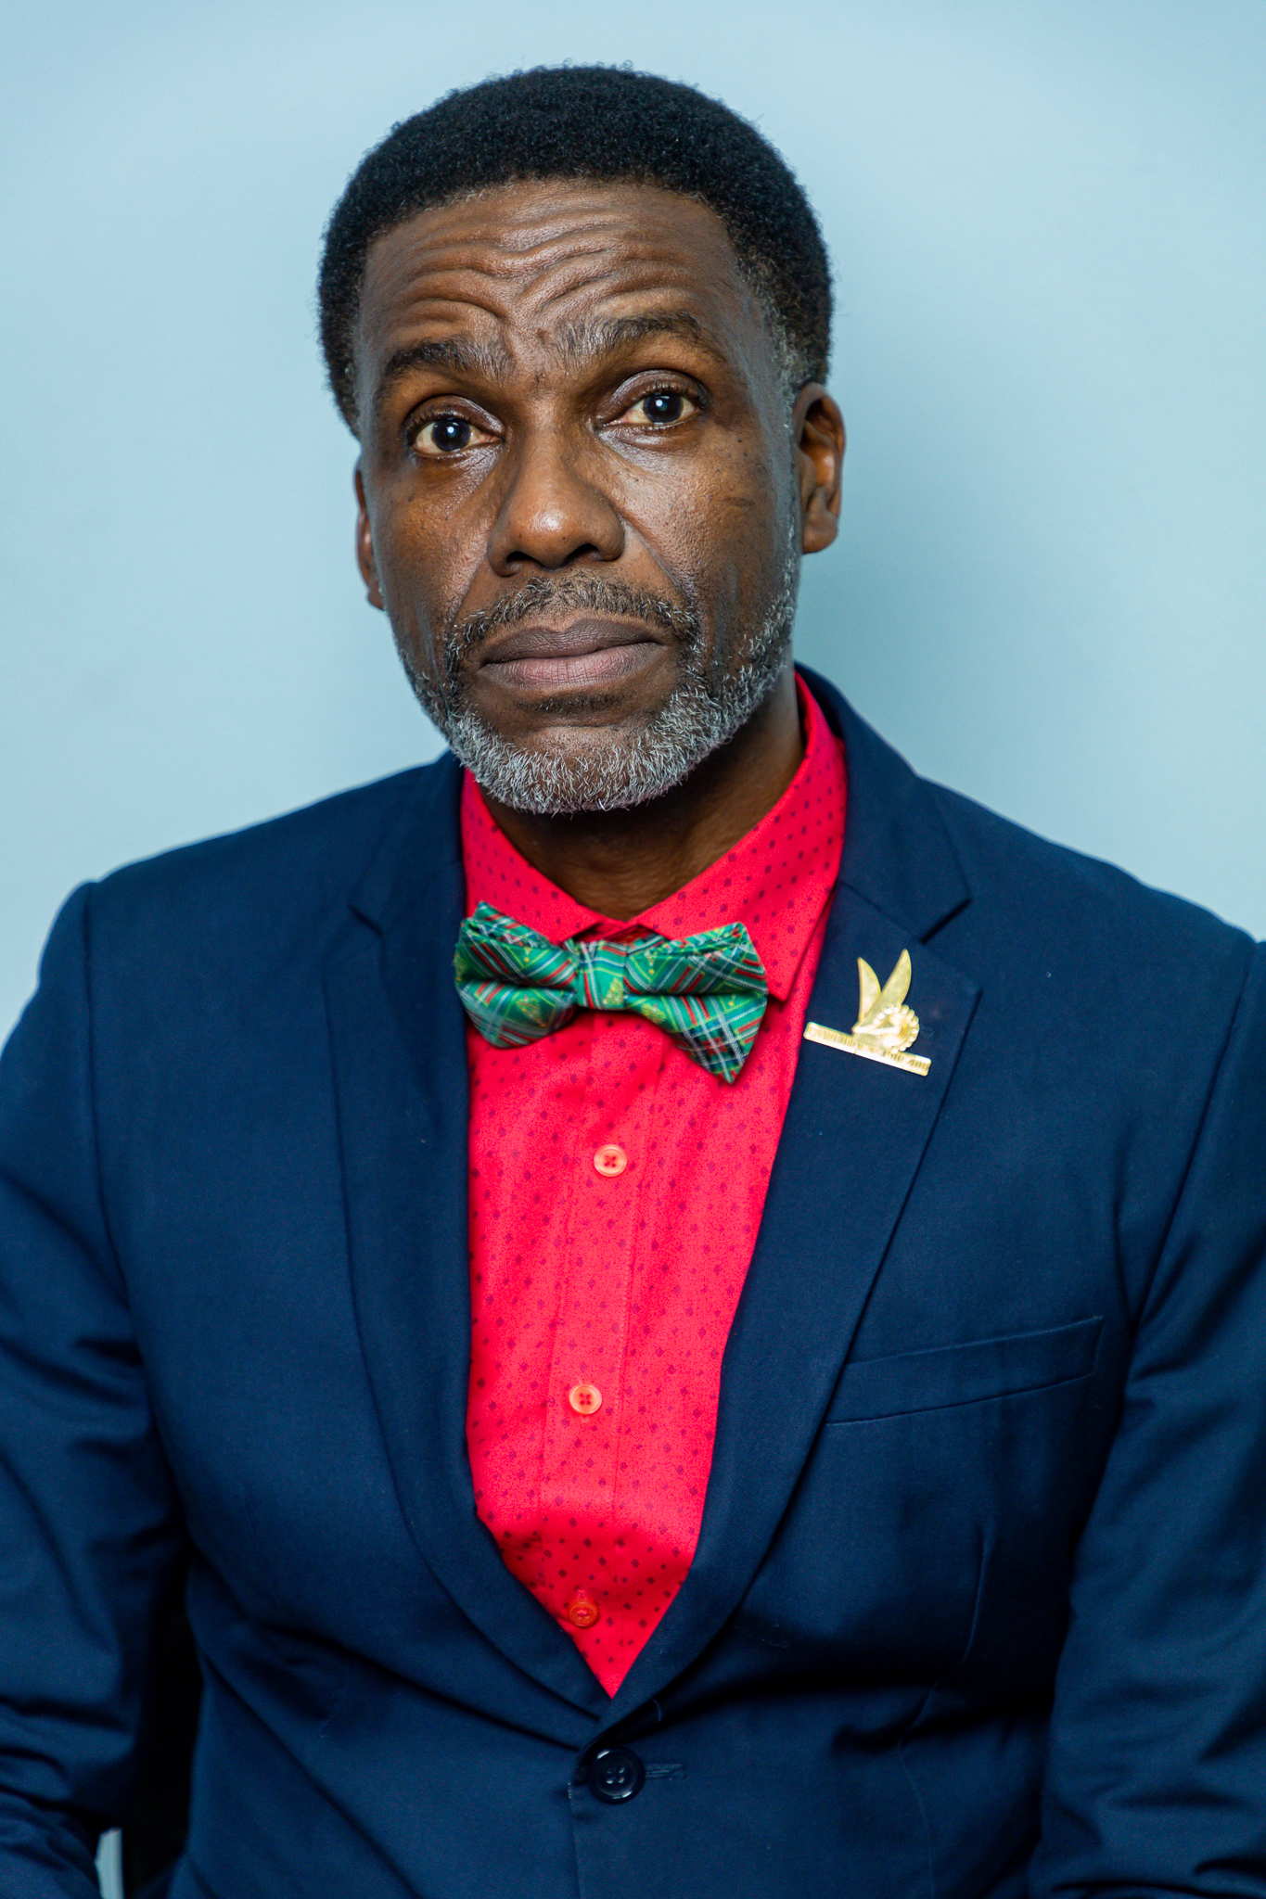
BARBADOS
Bishop Selwyn Brathwaite
Credential Workers - 57
Churches - 22

Slide 25
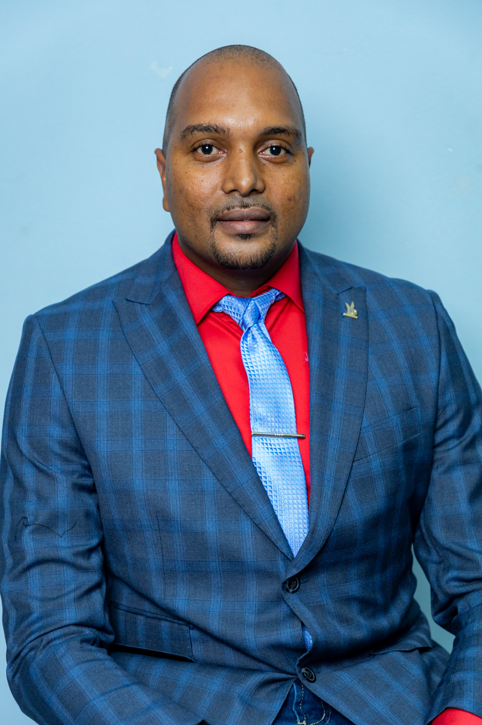
DOMINICA
Bishop Jerry Laurent
Credential Workers - 67
Churches – 23
Avg. Membership - 1050

Slide 26
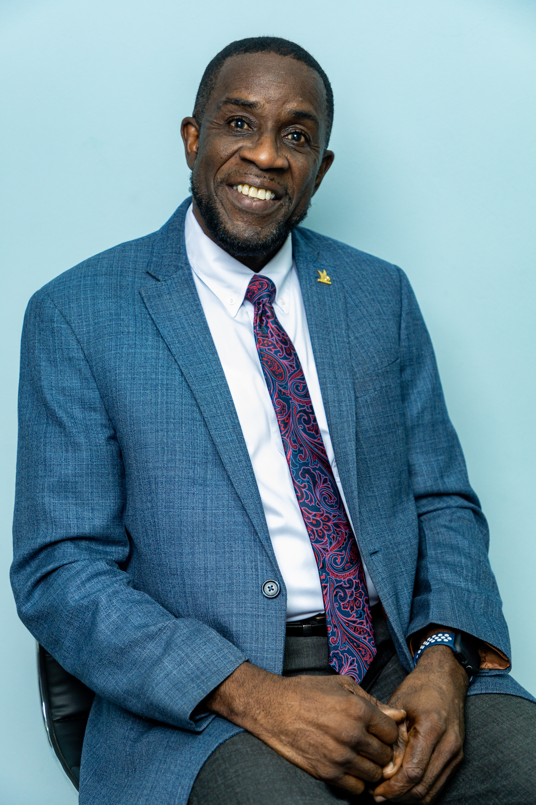
GRENADA
Bishop Christopher Baker
Credential Workers - 41
Churches – 25

Slide 27
MONTSERRAT
Bishop Raymond Boca
Credential Workers - 5
Churches – 1
Avg. Membership - 110

Slide 28
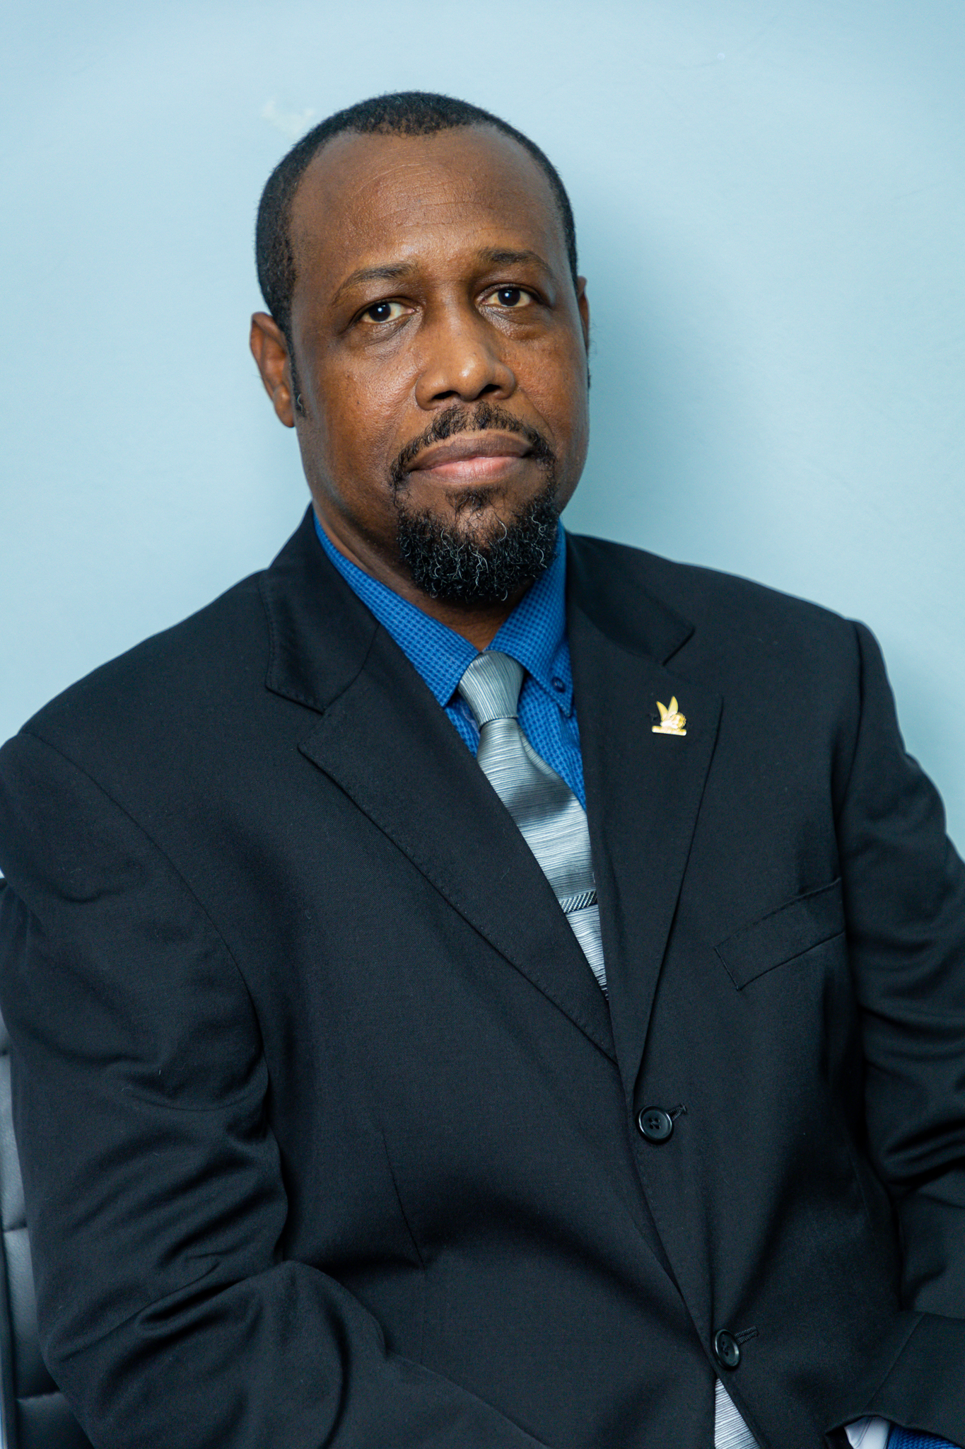
St. Lucia
Bishop Kendell Augustin
Credential Workers - 38
Churches – 23

Slide 29
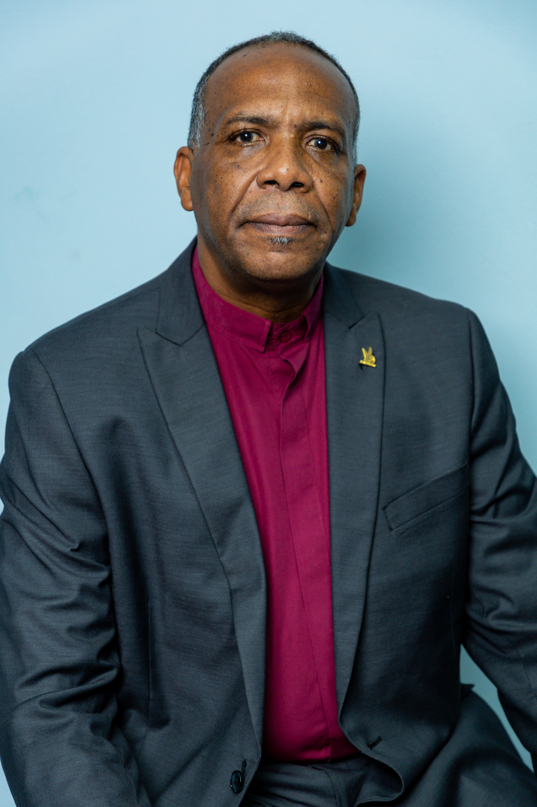
St. Vincent & The Grenadines
Bishop Stephen Ollivierre
Credential Workers - 54
Churches – 16

Slide 30
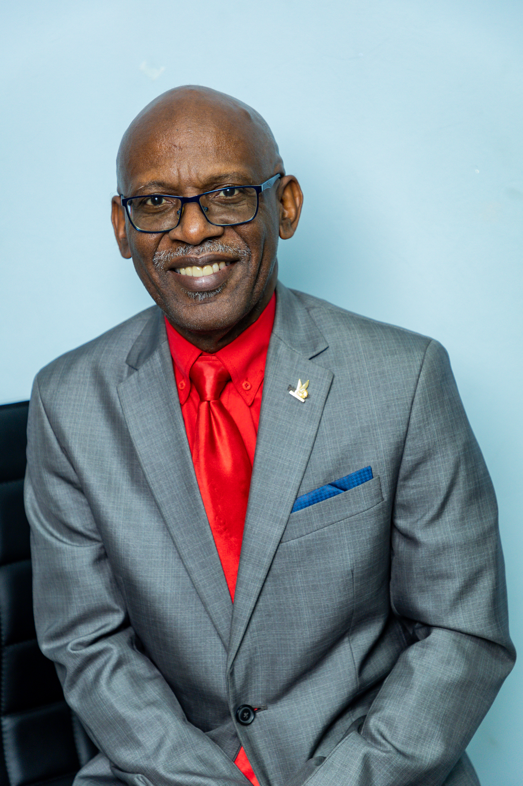
PAWI Trinidad & Tobago
Bishop Don Hamilton
Credential Workers - 320
Churches – 109

Slide 31
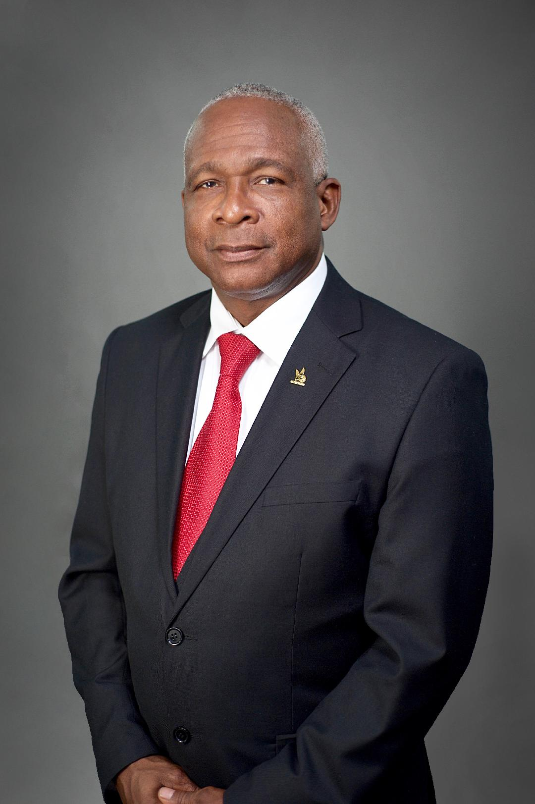
Central Trinidad District
Bishop Pat Glasgow
Churches - 9
Credential Workers - 29
Avg. Membership - 225

Slide 32
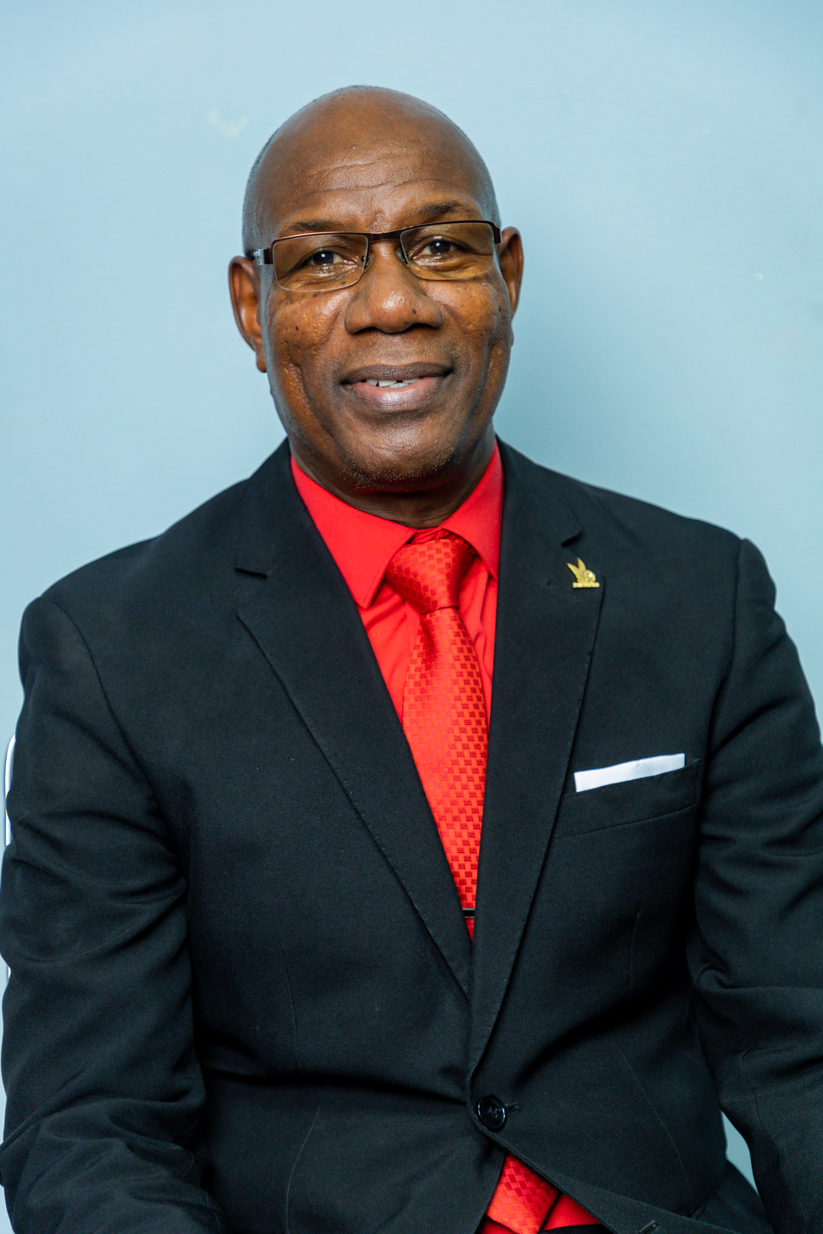
North East Trinidad District
Bishop Melch Pope
Churches - 32
Credential Workers - 93
Avg. Membership - 4399

Slide 33
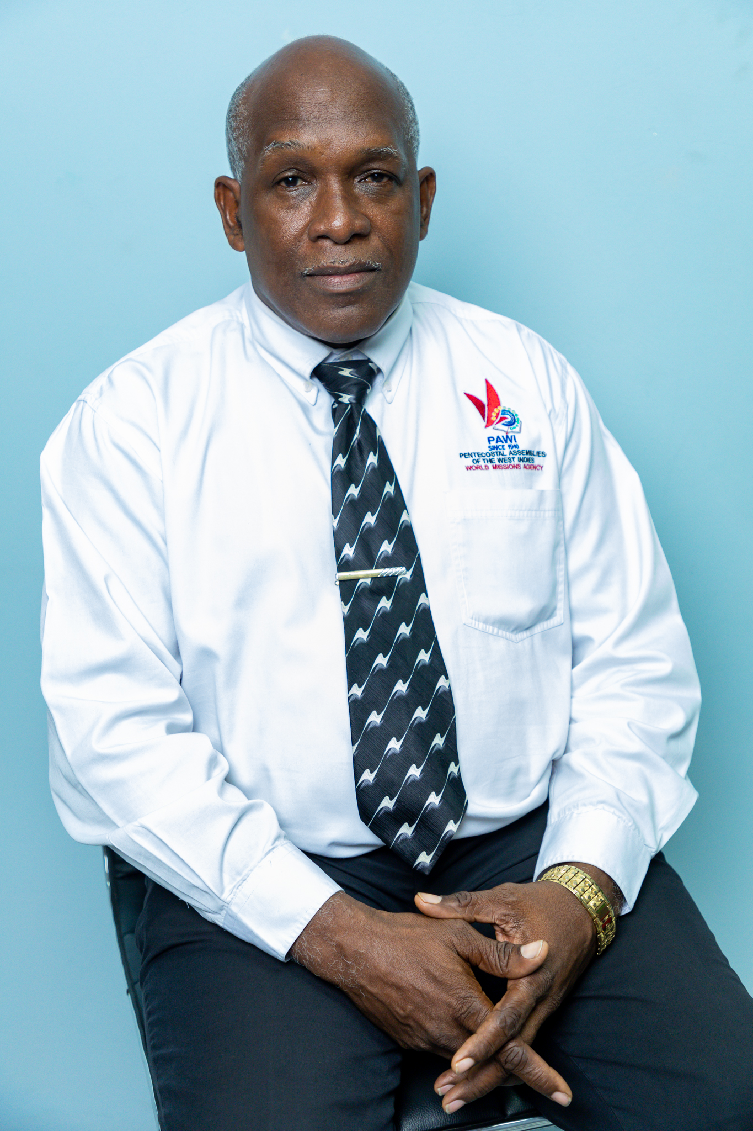
North West Trinidad District
Bishop Derick Henry
Churches - 24
Credential Workers - 84

Slide 34
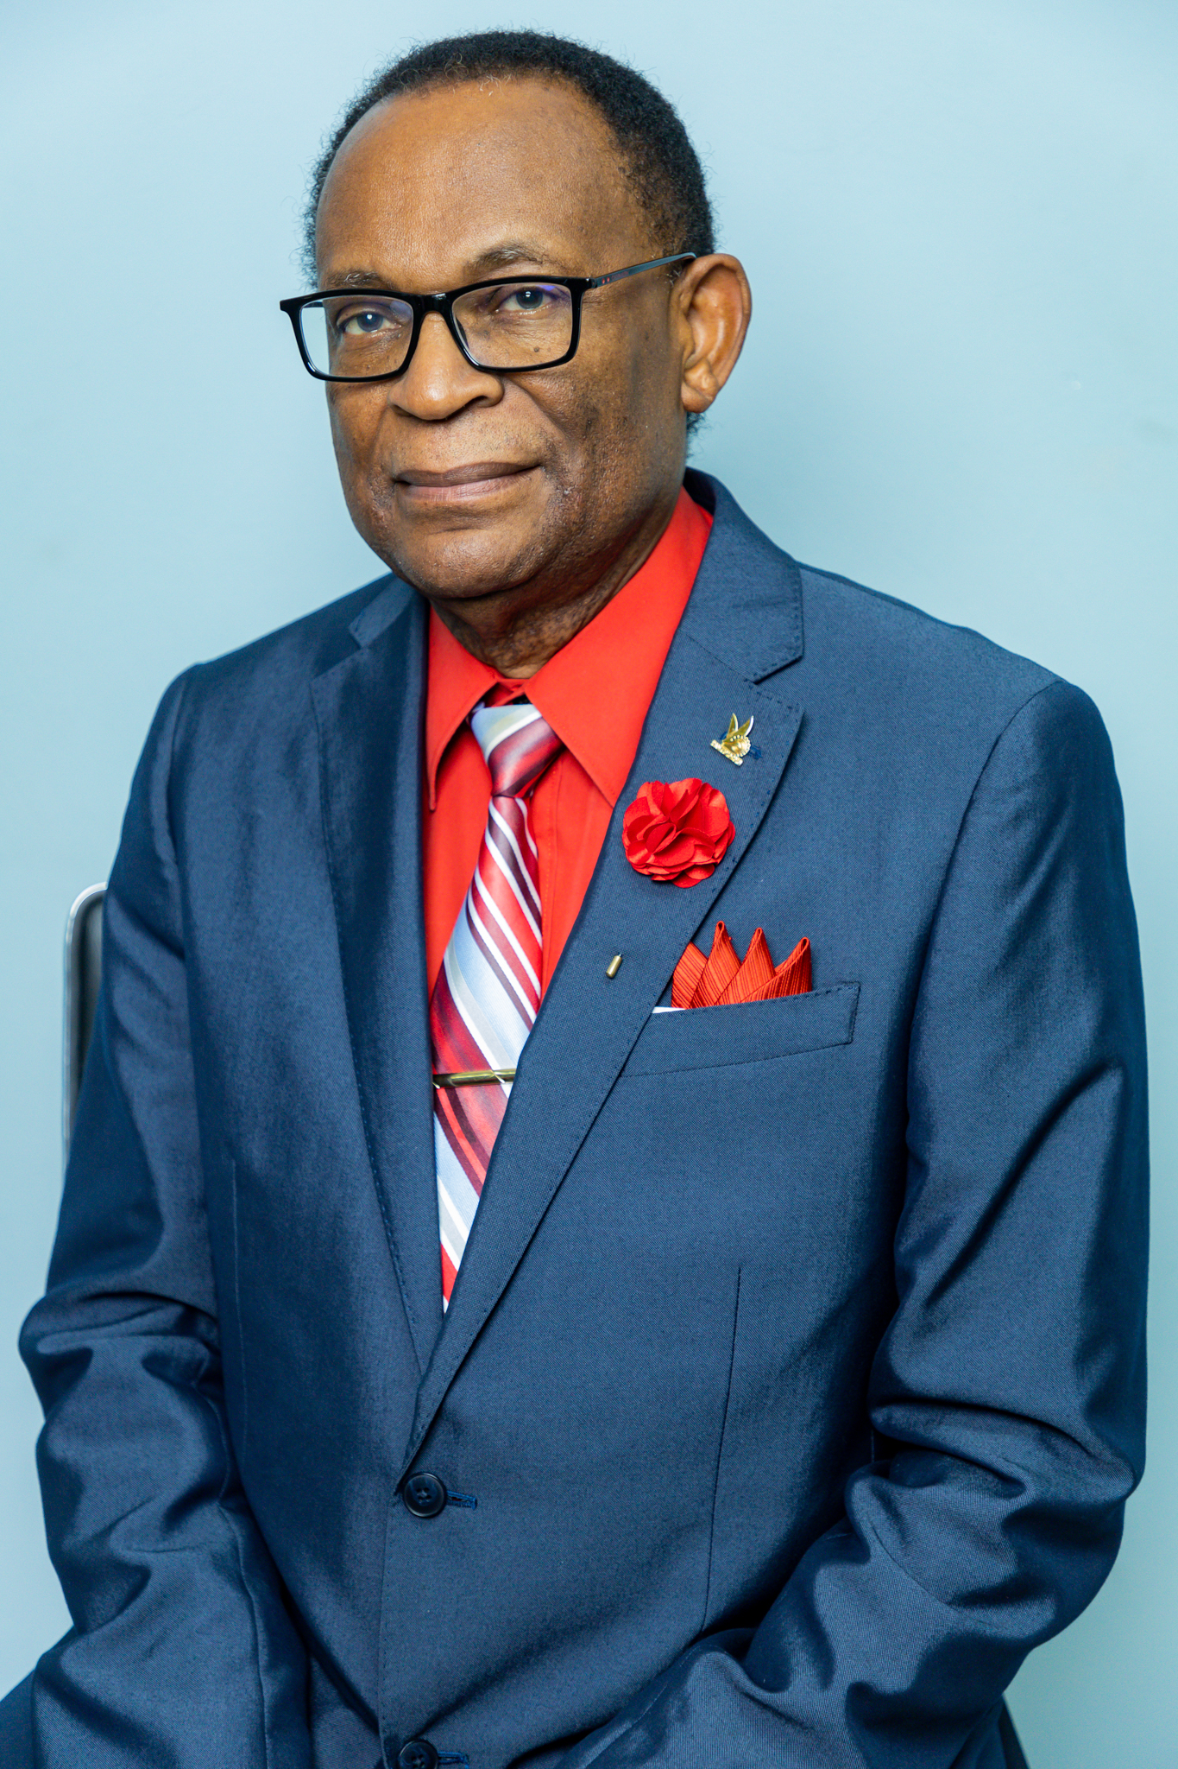
South Trinidad District
Bishop Anthony Roberts
Churches - 25
Credential Workers - 68

Slide 35
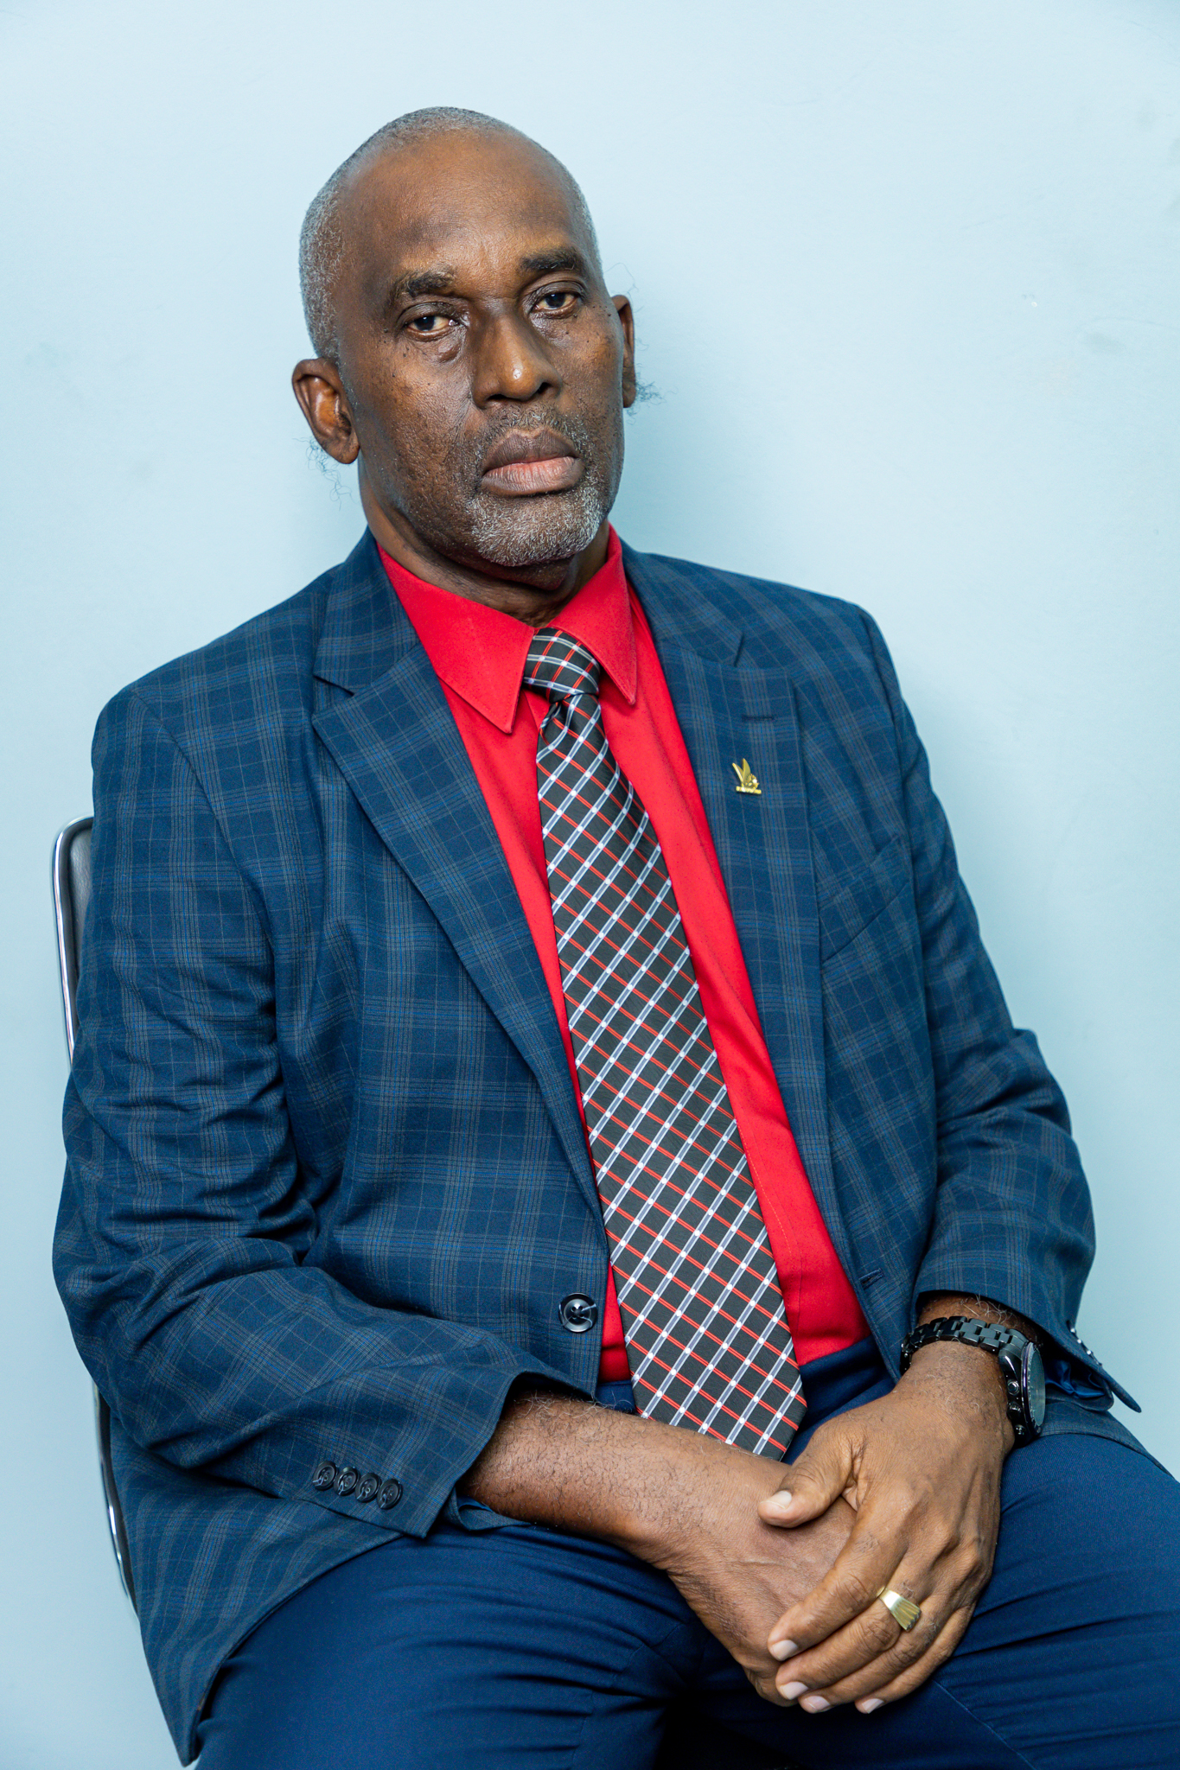
Tobago
Bishop Knowles McCall
Churches - 19
Credential Workers - 56

Slide 36
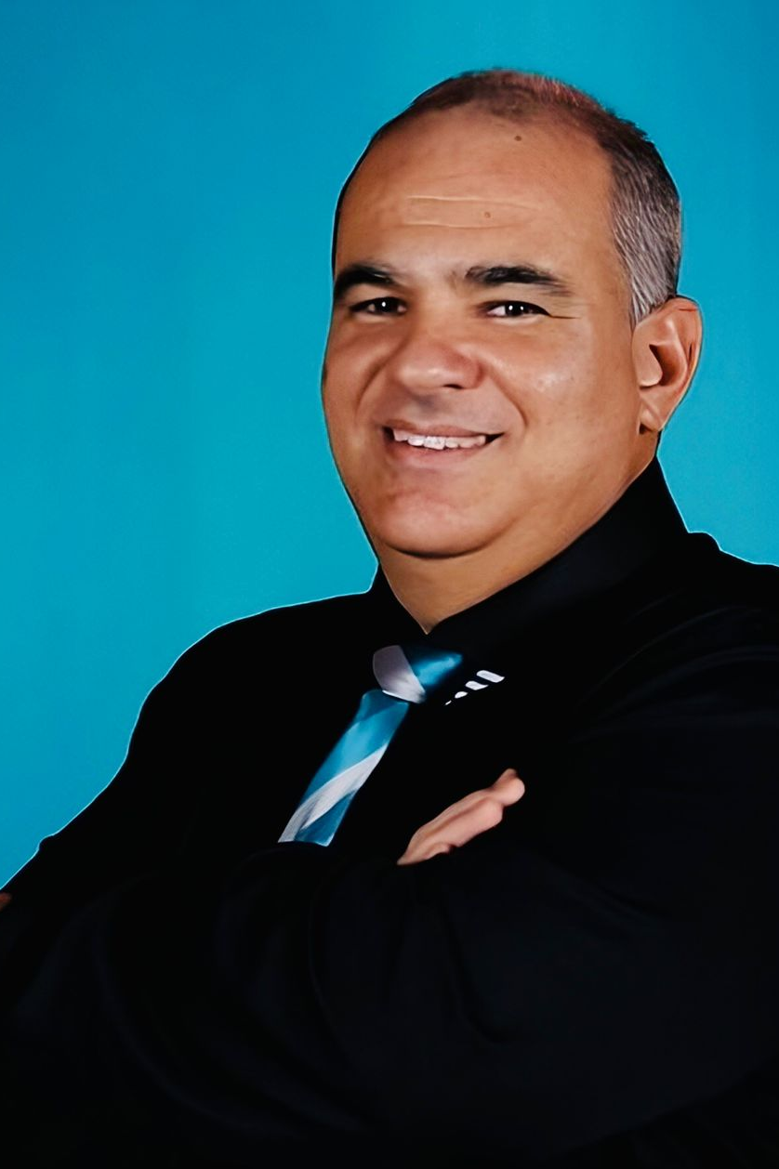
PAWI International Brasil
Bishop Emerson Luis de Silva Fonseca
Credential Workers - 6
Churches – 22

Slide 37
Head Office:
4th Bridge, Maracas Royal Road
St. Joseph. Trinidad & Tobago
Phone:
(868) 750-9796
Website:
Pawionline.org
Email:
pawi@pawionline.org

