Slide 1

Praise
& Preparedness
Pentecostal Assemblies of the West Indies World Missions Agency
Emergency Management Preparation Guidelines for churches

Slide 2

Prepare
We Praise Your Church for deciding to:

Slide 3

Connect
We Praise Your Church for deciding to:

Slide 4

Respond
We Praise Your Church for deciding to:

Slide 5

Why?
The Caribbean is prone to HURRICANES

Slide 6
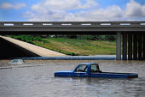
Why?
The Caribbean is prone to Floods

Slide 7
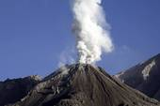
Why?
The Caribbean is prone to
VOLCANIC ERUPTIONS

Slide 8
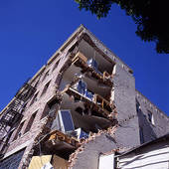
Why?
The Caribbean is prone to Earthquakes

Slide 9
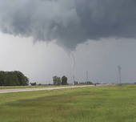
Why?
The Caribbean is prone to Tornados

Slide 10
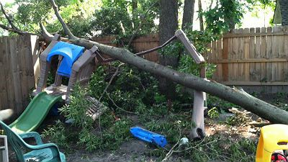
Why?
WHY?
Disasters are a Fact of Life
Virginia has trees

Slide 11
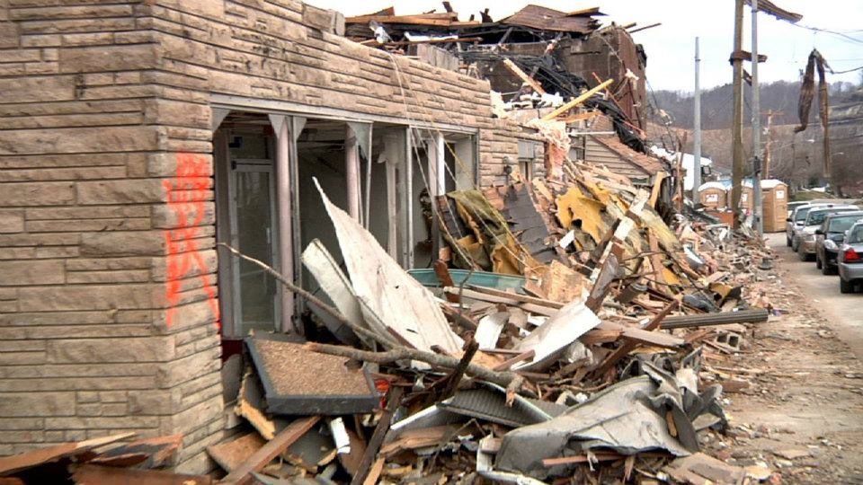
Most churches and organizations fail to prepare for any kind of disaster and miss ministry opportunities

Slide 12


Titus 3:1b - “…to be ready for
every good work.”
Titus 3: 14 – “And our people must also learn to devote themselves
to good works for cases of urgent need, so that they may not be unfruitful.”

Slide 13
Simply stated, this plan defines the roles and procedures that will enable the Pentecostal Assemblies of the West Indies International to:
1. Identify existing individual and corporate resources within the congregations that can be applied to disaster preparedness, mitigation and response.
2. Build individual and corporate resources among the District congregations to assist in disaster preparedness, mitigation and response.
3. Link individual and corporate resources in the District to meet humanitarian needs of human-caused and natural disasters and reduce vulnerability of people to potential disasters.

Slide 14
UNDERSTANDING DISASTERS
Phases of Disaster and Response
Phase 1: Warning/Anticipation
Phase 2: Impact/Emergency
Phase 3: Aftermath/Inventory
Phase 4: Relief/Remedy
Phase 5: Recovery/Reconstruction

Slide 15
Our mission is to establish and manage disaster preparedness and response protocols that will effectively mitigate disasters affecting our church’s membership, community and our local church facilities.

Slide 16
This plan seeks to:
1. Equip our staff and congregation with the necessary information, training and preparation to protect themselves and the local church facilities.
2. Identify means of contact in the immediate aftermath of a disaster and identify the immediate needs of the membership.
3. Have available reasonable protocols for identification and arrangements for appropriate individuals, parties, or agencies to address spiritual, emotional, and physical needs arising out of a disaster.
4. Establish budgets and mitigation efforts to secure the church. Develop alternative communication systems.

Slide 17
5. Seek out human and physical resources, and prepare contingency plans for employment of these resources to assist staff and members in a disaster event.
6. Organize, select and train preparation and response personnel, determine who is in charge. (Recognize that the Pastor should not be that person and decide who will activate the protocols.)
7. Recognize that operations do not take place in a vacuum. Learn about and cooperate with other preparation and response agencies. Do not attempt to perform the work of first responders such as police, firefighters, Red Cross, etc. Coordinate with all local organizations that are involved in emergency response.

Slide 18
Churches should have individuals who are responsible for the roles and functions in the three assignments that follow:
1. Local Church Disaster Coordinator
• Serves as Chairperson of the overall team
• Schedules and plans meetings
• Schedules and plans training
• Recruits a disaster team
• Ensures team readiness
• Liaisons with community established disaster relief groups
Work steadfastly with Pastor

Slide 19
2. Disaster Volunteer Coordinator
• Conducts skills and talent survey
• Develops a database of volunteer skills
• Identifies members needing special assistance and pairs them with members responsible for maintaining contact
• Develops a communications chain and arranges for its activation
3. Resource Coordinator
• Conduct inventory of facilities, supplies and equipment
•Coordinate with the Local Church Disaster Coordinator all information disseminated to the congregation regarding the use of facilities, equipment
• Maintain supplies in good order and replenishes as necessary

Slide 20
Prepare
Get:
Trained
Connected to respond
Develop:
A Strategic Plan

Slide 21
Connect
To the people in your community that can help you respond
To the people in your community that may need your assistance
To your District Disaster Coordinator that can help enable you to be prepared

Slide 22
Respond
The church must develop strategy for response to the needs of the local community
The church must establish code of behavior to use the church’s facilities when disaster occurs

Slide 23

Church Plan
Should assess the most likely disaster threats
Should be flexible and adaptable
Should consider the needs of
individuals and families
Should include specific ministries and target strategic areas where the church can have real impact
Should remember, “ministry is the act of serving”
Should include training for members in ministering to those caught in crisis

Slide 24
Organizing for Disaster Response
Develop a Response team
Contact local emergency management to assess hazards
Talk to other churches and disaster organizations to assess needs and identify gaps of ministry
Identify ministry points of contact
Develop ministries that fit the giftedness of the church body
Train team to enable effective response

Slide 25
Having the Ideal Church facilities for Disasters:
Disaster Shelter (During)
Storage unit
Bulk distribution centre - food, clothing, supplies
Child-care centre
Communication centre
Command centre
Counselling room
Feeding site
Information centre
Shelter for victims
Muster areas

Slide 26
Response Ready
Identify and train volunteers to care for children, the elderly, sick or disabled
Identify bilingual interpreters to assist those who speak another language
Participate in community services such as receiving and organizing donated goods, bedding, bulk food, clean-up, and household supplies
Provide logistical support to trained disaster relief volunteers such as housing and meals
Cooperate with community disaster agencies
Develop and organize clean-up or repair crews,
such as chainsaw, debris clean-up,
flood relief, and roof tarp teams
Organize and participate in re-build efforts

Slide 27
Ready Church Response
Contact and minister to church shut-ins, elderly, disabled, and single mothers following disasters by developing a vulnerable phone list pre-disaster.
Offer your church as a resource center for helping agencies to assist affected victims.
Train Ministers to provide spiritual care to those affected by disaster and those serving as responders.
Consider making your church available as a shelter.
Collect and distribute blankets, clothing vouchers, or furniture to fire victims, or teddy bears and children’s blankets to affected families

Slide 28
Response Teams should plan and execute
2-3 events yearly to:
Increase response effectiveness
Maintain strategy focus
Grow team unity
Develop community relationships

Slide 29
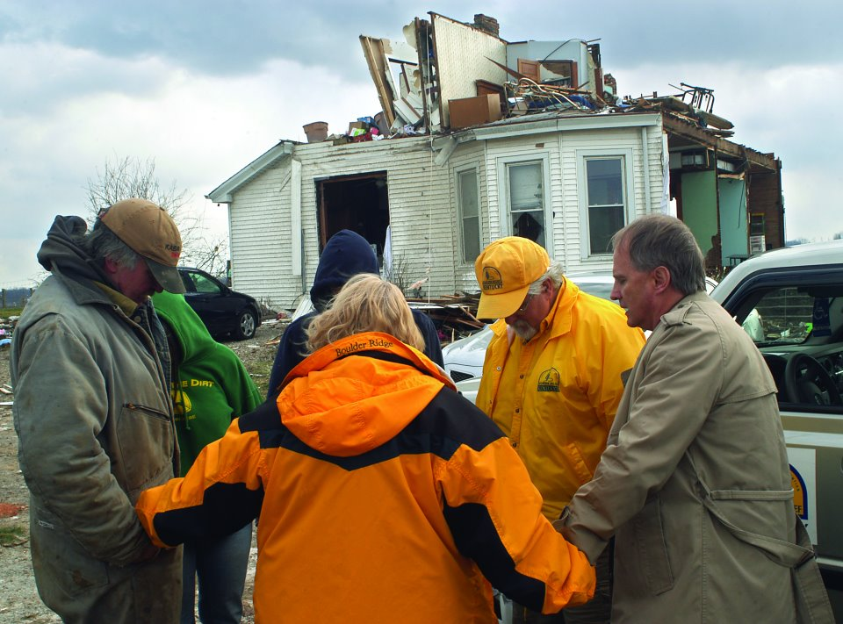
A Ready Church
Provides a tremendous opportunity to share the help, healing and hope of Christ

Slide 30
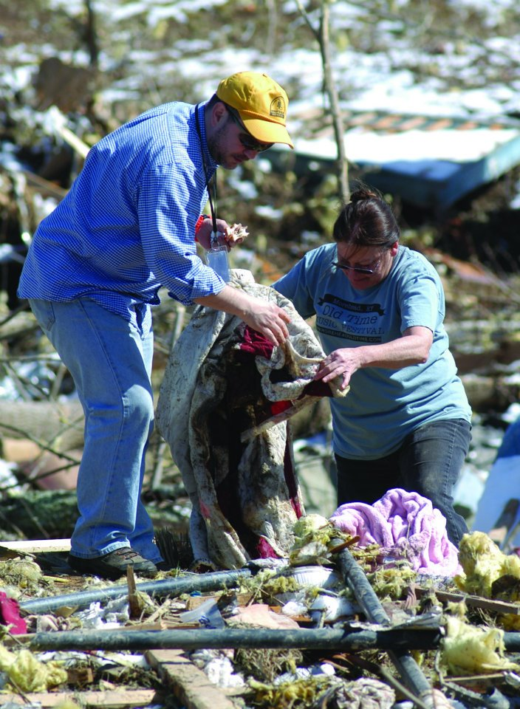
“Dear children, let us not love with words or speech but with actions and in truth.” (1 John 3:18)

